Slide 1
DATA STRUCTURES AND ALOGRITHMS USING PYTHON- PART2

Slide 2
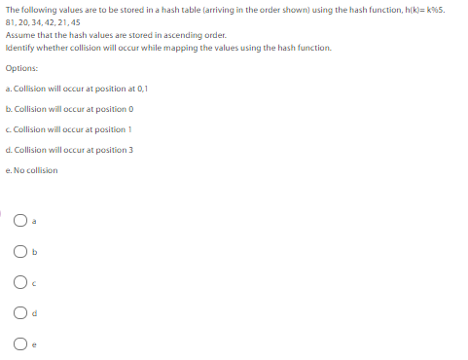
Hashing & Hash Table
Q1

Slide 3
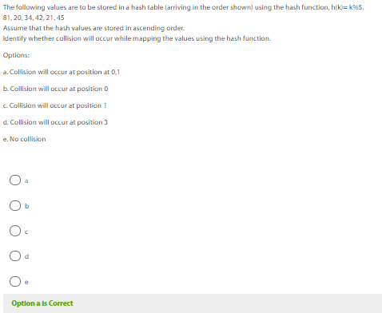
ANSWERS

Slide 4
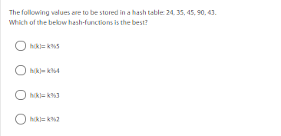
Q2

Slide 5
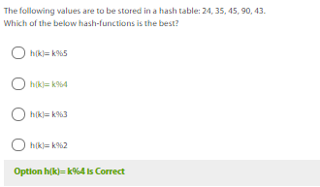
ANSWERS

Slide 6
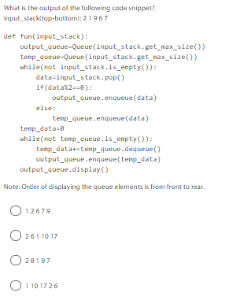
Stack & Queue
Q1

Slide 7
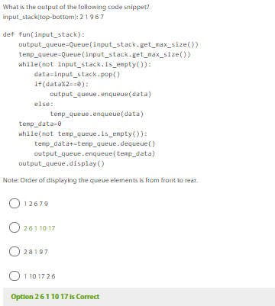
ANSWERS

Slide 8
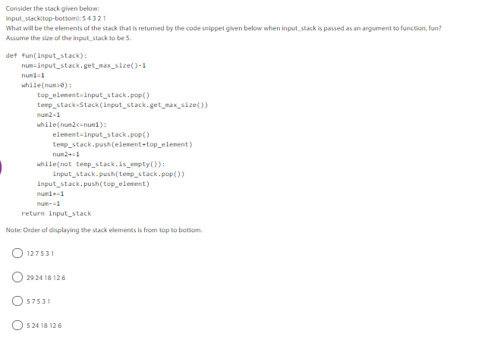
Stack - Summary
Q1

Slide 9
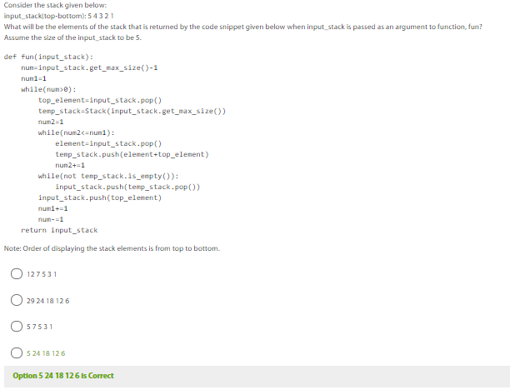
ANSWERS

Slide 10
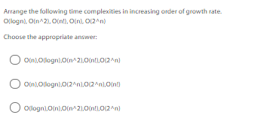
Analysis of Algorithms
Q1

Slide 11
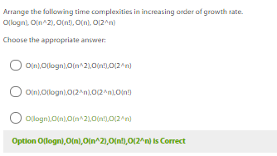
ANSWERS

Slide 12
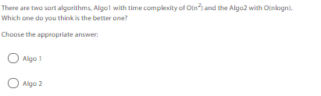
Q2

Slide 13
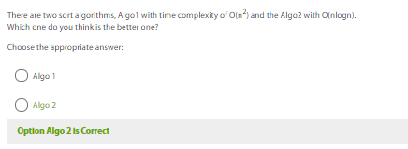
ANSWERS

Slide 14
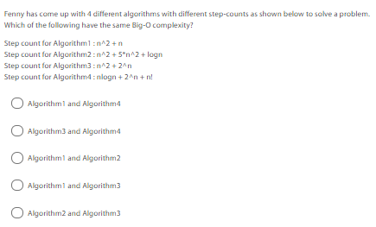
Q3

Slide 15
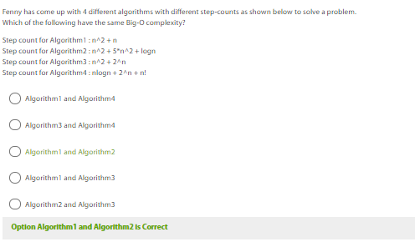
ANSWERS

Slide 16
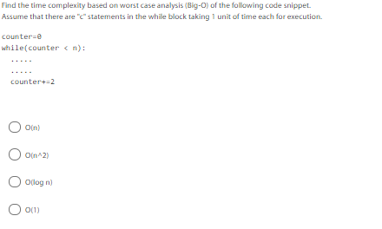
Q4

Slide 17
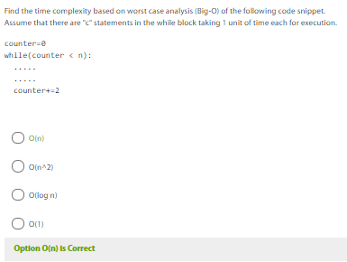
ANSWERS

Slide 18
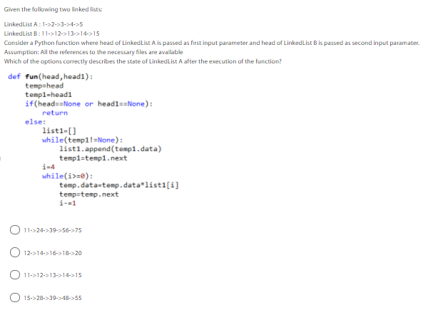
Practice Quiz
Q1

Slide 19
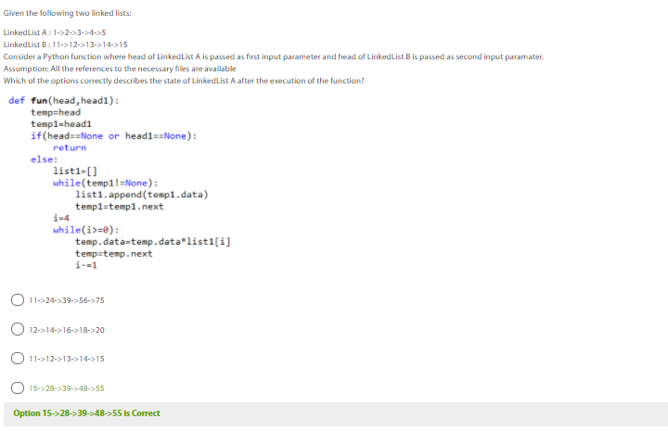
ANSWERS

Slide 20
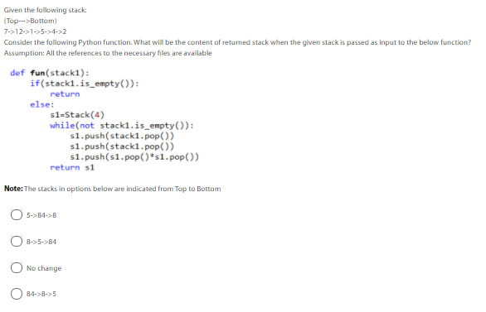
Q2

Slide 21
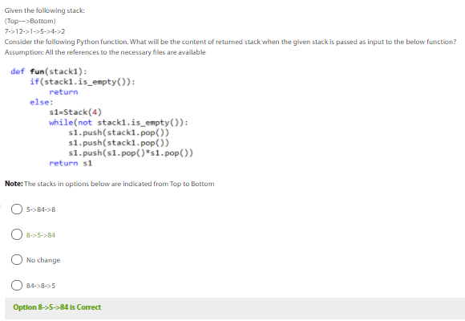
ANSWERS

Slide 22
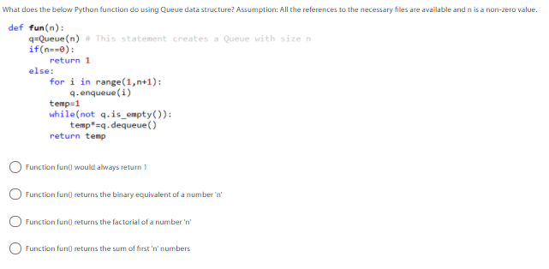
Q3

Slide 23
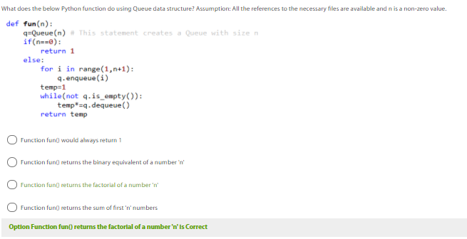
ANSWERS

Slide 24
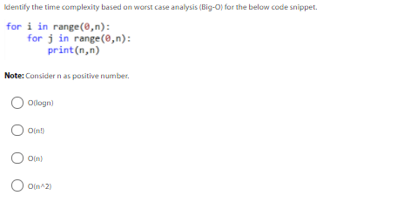
Q4

Slide 25
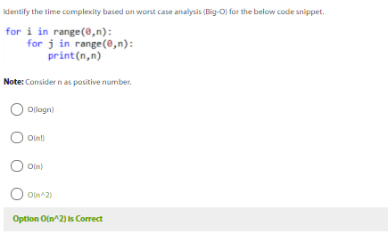
ANSWERS

Slide 26
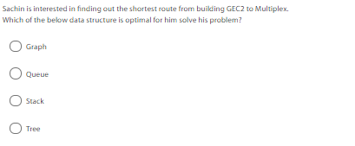
Q5

Slide 27
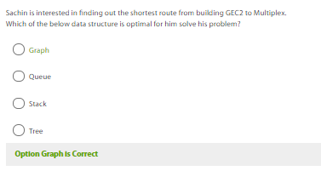
ANSWERS

Slide 28
THANK YOU

